Slide 1

Healthcare Management
Nikhil Teotia

Slide 2

Introduction
In this presentation we’ll be talking about healthcare data—specifically, the opportunities it offers and the challenges that come with it. We’ll also show how using data visualization tools like Power BI can help hospitals improve how they’re managed, provide better care to patients, and make smarter decisions for the future.
In this presentation, we’ll walk you through a Power BI dashboard that gives a detailed look at healthcare operations and how data can be used to make things more efficient and effective."

Slide 3
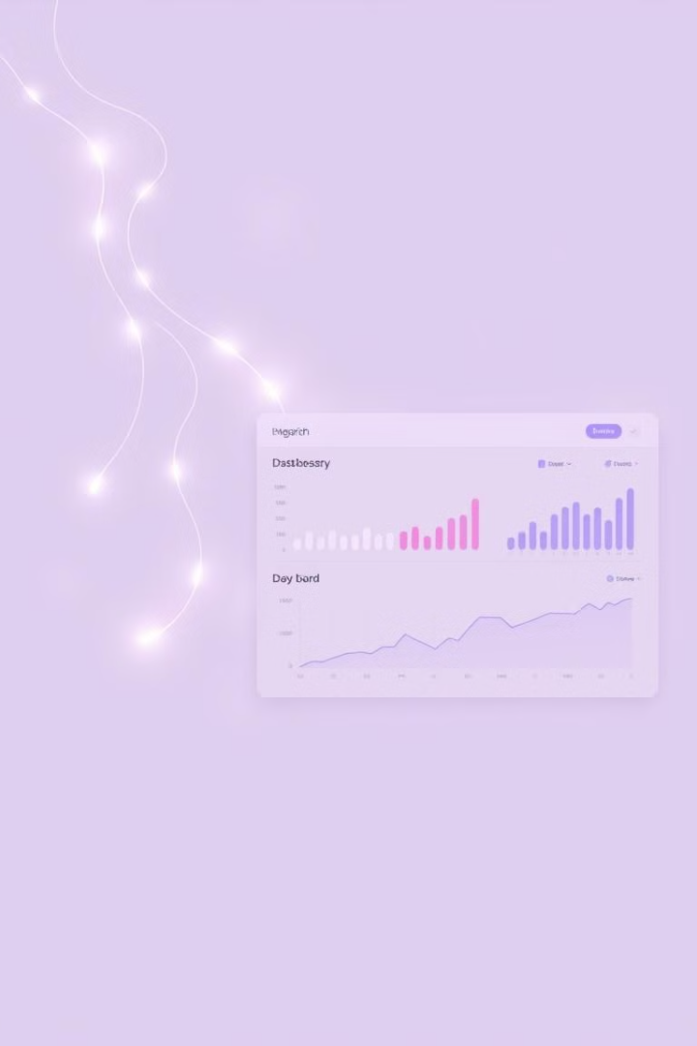
Abstract
Data-Driven Insights
Interactive Metrics
This report presents an analysis of a healthcare dataset using Power BI, revealing key insights into hospital operations. It covers patient demographics, staff distribution, and departmental performance, enhancing visibility for data-informed decisions.
The dashboard uses interactive visuals and metrics such as bed occupancy rates and gender distribution. This dynamic approach enables healthcare administrators to monitor trends and make strategic adjustments.
Operational Empowerment
By providing tools to analyze and interpret complex datasets, the dashboard empowers healthcare administrators. They can now make data-informed decisions that lead to improvements in patient care and hospital management.

Slide 4
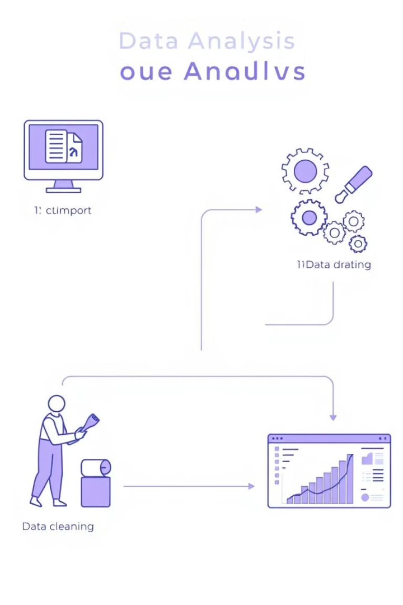
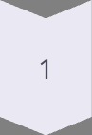
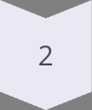
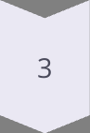
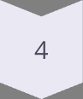
Methodology
Data Import
Hospital records were imported into Power BI, ensuring all relevant data was accessible for analysis.
Data Preprocessing
The data underwent filtering, cleaning, and transformation to ensure accuracy and relevance.
Custom Measures
DAX was used to create custom measures for key performance indicators (KPIs), providing deeper insights.
Visual Creation
Bar charts, pie charts, tables, and line graphs were used to present data effectively.

Slide 5
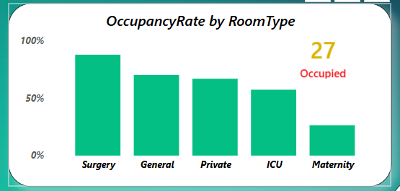
Visuals: Bed Occupancy & Patient Distribution
1
Bed Occupancy Analysis
This dashboard visualizes bed occupancy rates across different departments. High occupancy in surgery and general rooms indicates strong demand. Low occupancy in maternity and ICU units suggests potential resource reallocation.
2
Patient Distribution Overview
The patient distribution dashboard provides a detailed view of patient demographics. It shows gender distribution, age ranges, and geographical locations, helping tailor healthcare services to specific needs.
3
Data-Driven Decisions
Insights from these visuals support data-driven decisions in resource allocation and service improvements, ensuring optimal patient care and hospital management.

Slide 6
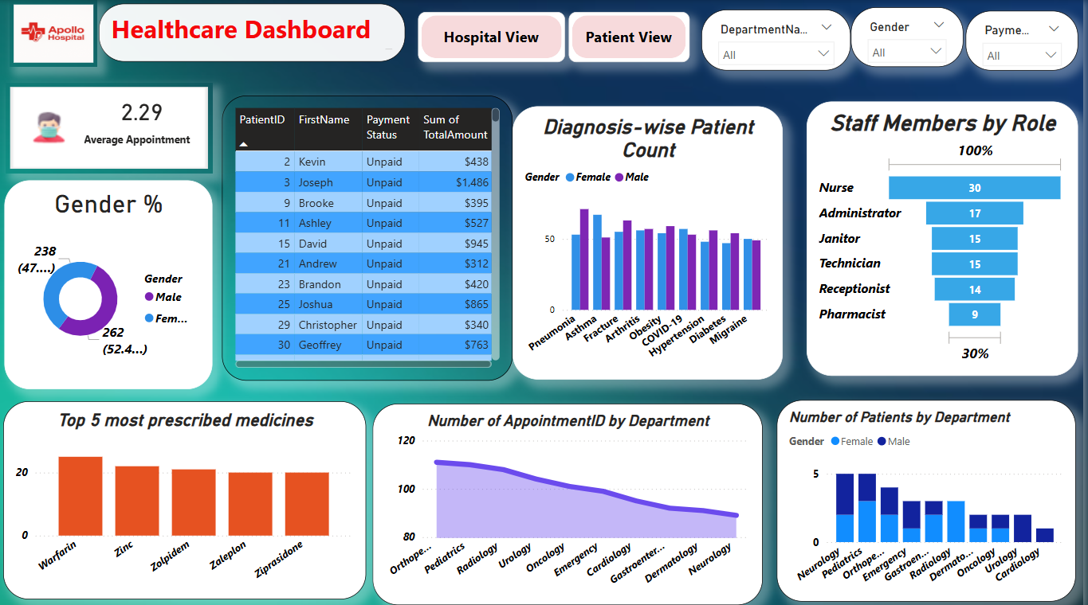
Visuals: Appointment Trends & Diagnosis
Appointment Trends
Common Diagnoses
Analysis of appointment trends highlights peak periods and workload distribution. Doctors Erika and Caleb handle the most appointments, suggesting a need for workload balancing.
The dashboard identifies the most common diagnoses, such as pneumonia, asthma, and fractures. This data supports targeted care and resource allocation for prevalent conditions.
Identifies busy periods
Highlights prevalent conditions
Reveals doctor workload distribution
Supports targeted care initiatives

Slide 7
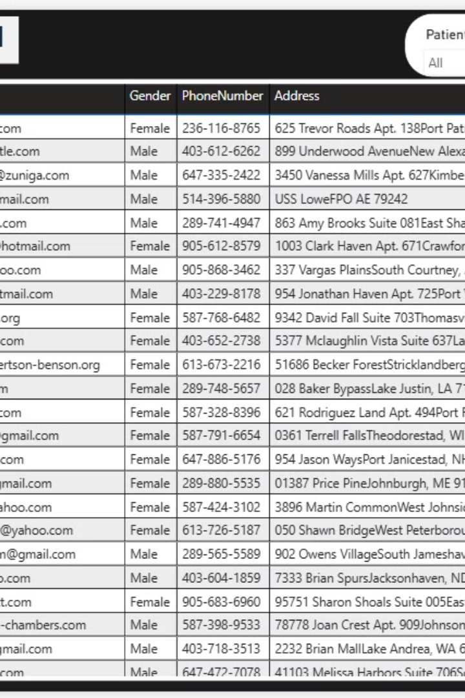



Visuals: Cost Analysis & Gender Split
Cost Analysis
Gender Split
Top Medicines
The average treatment cost is $519. This information enables cost management and resource optimization strategies. Unpaid bills suggest billing process improvements.
The gender split is approximately 52% female and 48% male. This demographic insight supports gender-specific care and resource allocation.
The most frequently prescribed medicines include Warfarin, Zinc, and Zolpidem. Data-driven medication management is essential for improved healthcare outcomes.

Slide 8

Key Results & Insights
500
100
Total Patients
Total Staff
The hospital serves a substantial patient population.
The staff supports patient care and hospital operations.
50
Total Doctors
The doctors provide expert medical care across departments.
The hospital’s operational metrics, including total patients, staff, and doctors, provide a foundation for strategic decision-making. High occupancy in surgery and general rooms requires close monitoring to ensure optimal resource allocation. Insights into average treatment costs, doctor workload, and common diagnoses contribute to efficient healthcare delivery and targeted patient care.

Slide 9






Discussion & Analysis
Workload Balance
Redistribute workload among doctors.
Occupancy Optimization
Optimize maternity and ICU occupancy.
Billing Improvements
Address high unpaid patient bills.

Slide 10
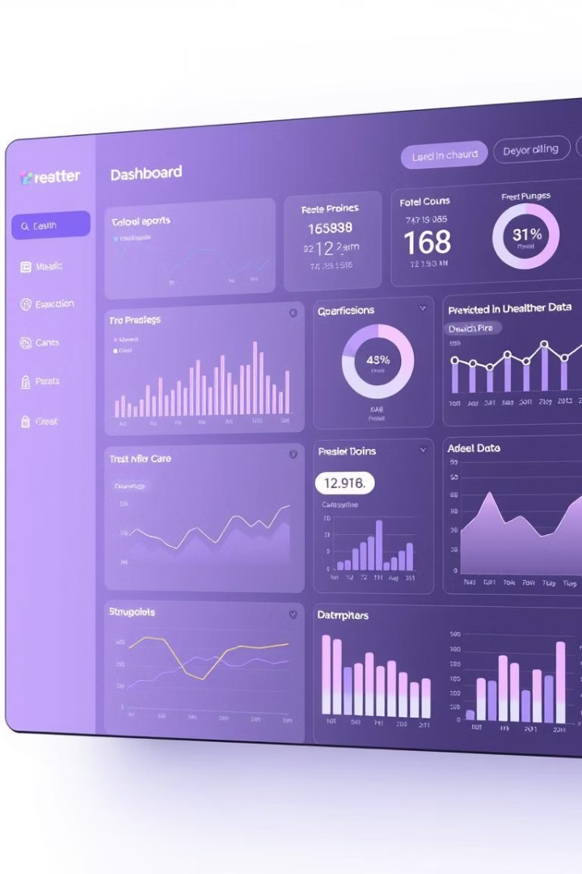
Conclusion
Operations Streamlined
Trends Identified
It identifies key trends in patient care, treatment costs, and staff distribution, enhancing visibility.
The Power BI dashboard effectively streamlines hospital operations analysis, providing actionable insights.
Decisions Empowered
The dashboard empowers data-driven decisions, leading to improved healthcare delivery and better strategic planning.

Slide 11


Slide 12


